Slide 1
COLLEGE OF INFORMATION AND COMMUNICATION TECHNOLOGY(CoICT).
PROJECT TITLE: SCHOOL BUS TRACKING MANAGEMENT SYSTEM
STUDENT NAME: NGAKWIRA,TUMANIEL T. 2020-04-09497 Bsc in CS.
MWAISELA, PETER ABEL. 2020-04-08600 Bsc in BIT.
SUPERVISOR NAME: Mr. MARCO MASEMBO.

Slide 2
Introduction of the system.
School Bus Tracking Management System is a web based and mobile based system which keep parents direct informed and easily notified about the movement of their children in school bus.
It monitor pick-up/ drop-off points of students to enhance safety of the children during their daily movement to and from school

Slide 3
Feasibility study
Technical feasibility
Risk basing on the familiarity of school bus tracking management system.
Our team is not familiar real-time database
Risk basing on the familiarity of technology is moderately high.
Our team has little knowledge and experience working with embedded system.
Risk basing on the familiarity of technology is moderately high.
The project time frame is somewhat critical, since it supposed to be delivered with short times.
Risk basing on compatibility is moderately high.
The project use new hardware devices to be installed on the school buses.

Slide 4
Organizational feasibility
From an Organizational perspectives, the project has low risks, the project supervisor and the team members have a strong interest on the project.
Also the users of the system are expected to appreciate the use of their mobile phone to keep track of their children

Slide 5
Economic feasibility
Development cost
Hardware and software costs.
Operational cost
Equipment upgrades

Slide 6
Requirements: stakeholders
School administrator - The one which deals with overall management of system
Parents – The one who tracks the bus and receive notifications about the bus
Bus driver-The one who transport students and send notifications once an emergence occurs.

Slide 7
Requirements: Collection
This involves collection of data from our stakeholders i.e., the school Admin, parents and drivers. The techniques used in gathering data were as follows;
Interview
We prepared open-ended questions that used to interview the school Admin, drivers and parents. From collected data we were able to generate a list of requirements such as functional and non-functional requirements.

Slide 8
System Functionalities
Core functional requirements.
System should allow administrator to manage users.
System should allow user to get real time information of the bus
System should allow admin to manage routes.
System should allow parent to declare emergence example sick of students.

Slide 9
Non- functional requirements
Usability - The system must be easy to use and understand to both Administrator and parents
Compatibility - The system must be compatible with variety of devices include
Computers, smart phone and tablets.
Performance - The system must provide real time update about bus location and arrival time and respond quicky to the user request.
Reliability - The system must be dependable and consistently and deliver an
accuracy information about bus location and arrival time.

Slide 10
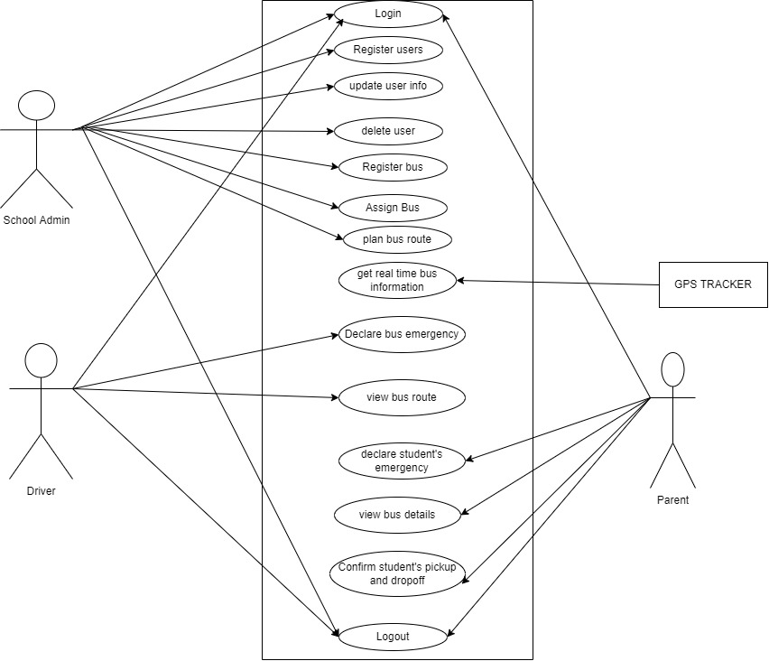
Use case

Slide 11
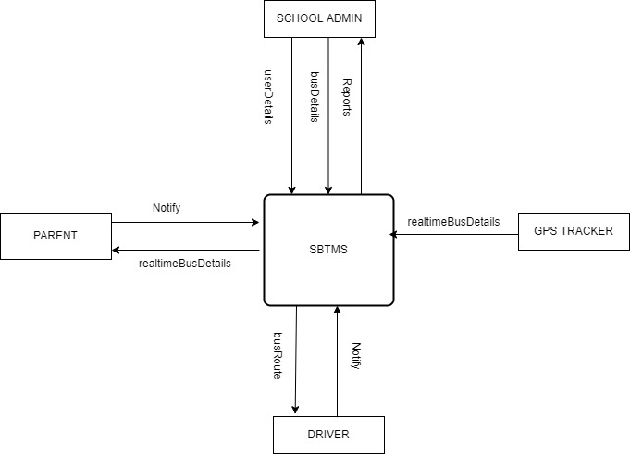
Process modeling

Slide 12
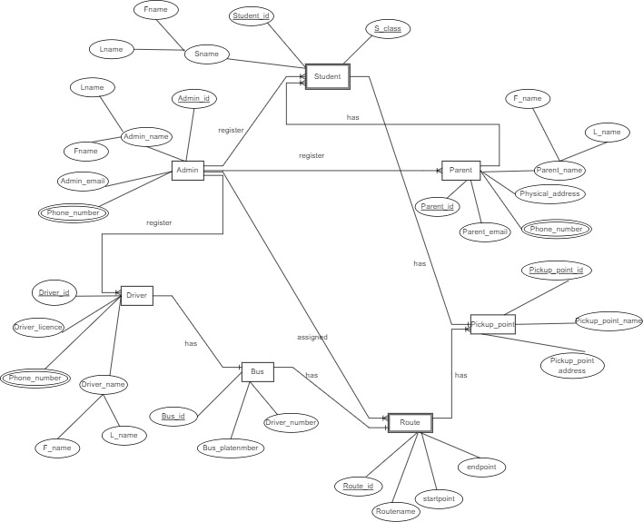
Data modeling
erd

Slide 13
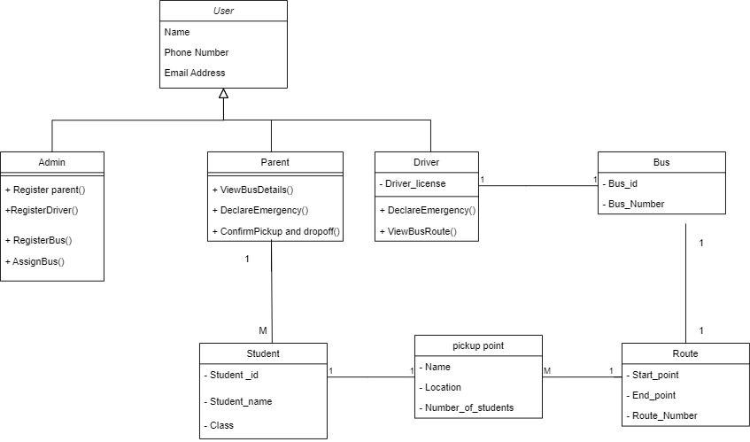
Design diagram
Class diagram

Slide 14
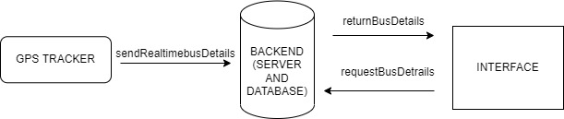
Architecture design

Slide 15
UI design

Slide 16
Thank you!

